Slide 1
SNAKES OF JALGAON DISTRICT (MS)
Presented By
DR. N. H. DESALE
Department of Zoology,
Kisan College, Parola, Dist. Jalgaon (MS)

Slide 2
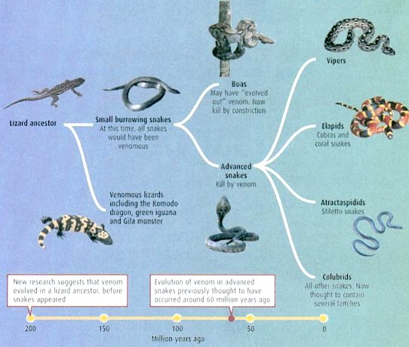
EVOLUTION OF SNAKES

Slide 3
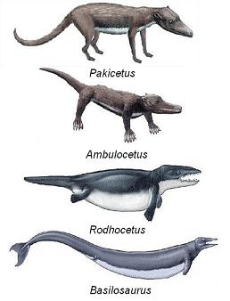
EVOLUTION OF SNAKES

Slide 4
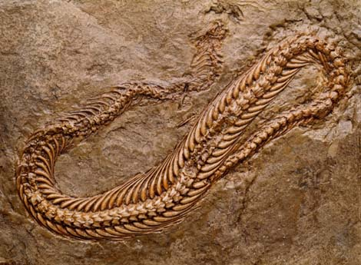
SNAKE FOSSIL

Slide 5
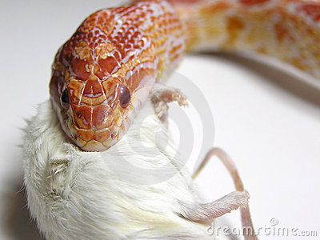
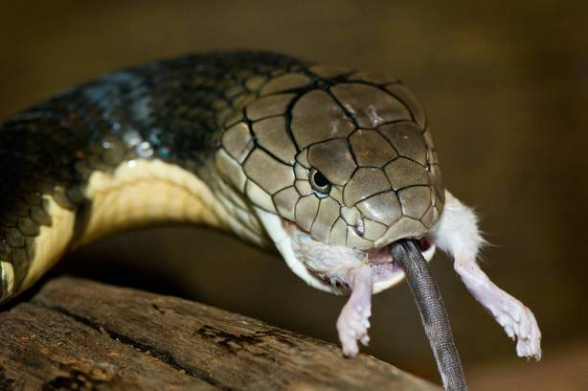
IMPORTANCE OF SNAKES
Important component of the Ecosystem.
Balance of Nature.
Great Benefit to Farmers.
Snakes help to control Rodents, Rats etc.
Medical importance.

Slide 6
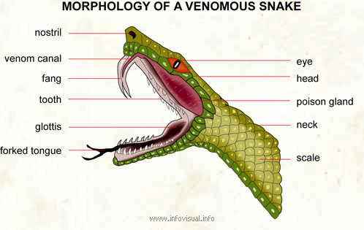
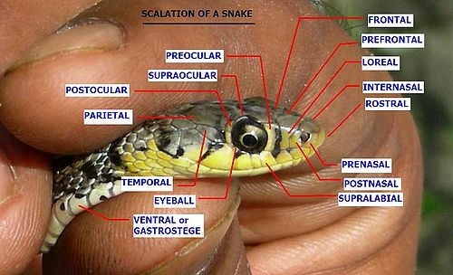
STRUCTURE OF SNAKE SCALES

Slide 7
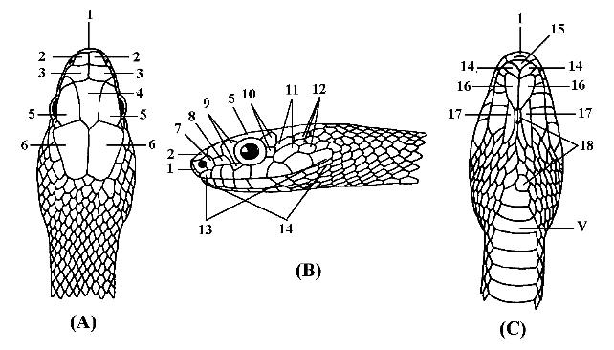
Scale Counting of ‘HEAD’
DORSAL VIEW LATERAL VIEW VENTRAL VIEW

Slide 8
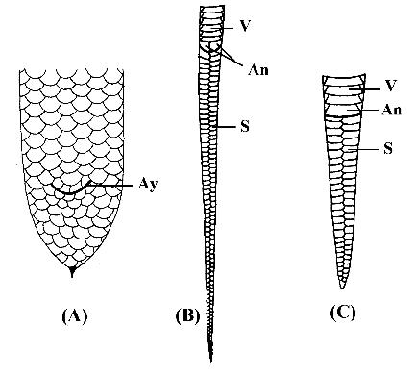
Scale Counting of ‘TAIL’

Slide 9
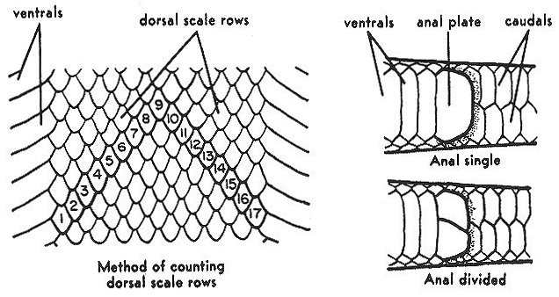

Slide 10
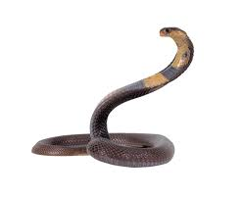
TYPES OF SNAKES
Non venomous snakes
Semi venomous snakes
venomous snakes

Slide 11
Non venomous snakes

Slide 12
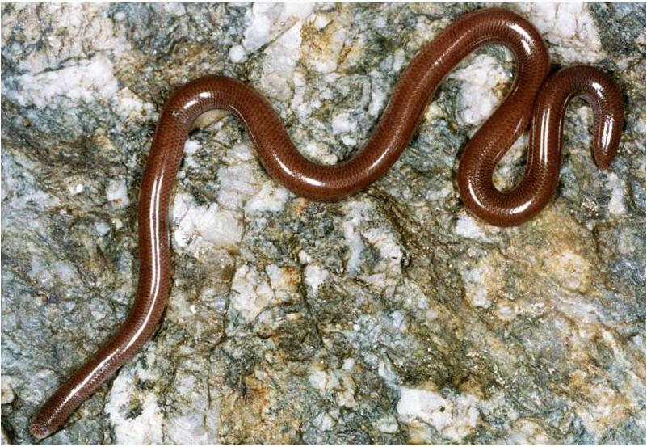
Worm Snakes
Ramphotyphlops braminus
Average Length: 12.5 cm
Max. length: 23 cm
Color: Reddish Brown
Shape: Rounded & Tail
Narrow
Habitat: Moist soil

Slide 13
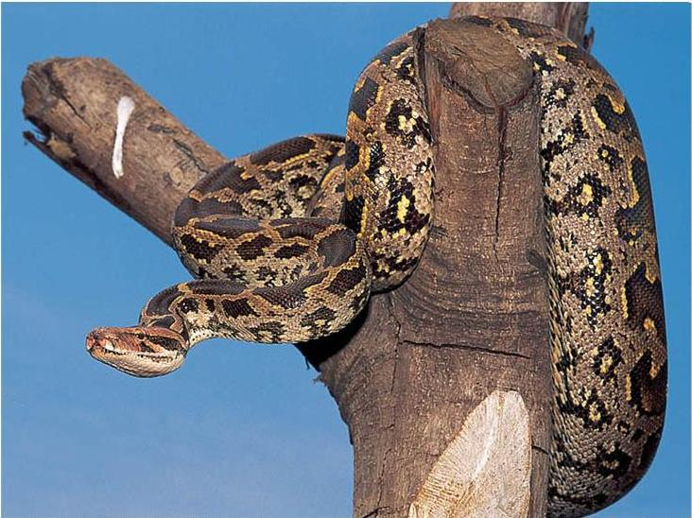
Indian Rock Python
Python molurus molurus
Average Length: 300 cm(9ft)
Max. length: 760 cm
Color: Grayish or faint
brownish
Shape: Large, Head triangular and tail
Habitat: In all over forest

Slide 14
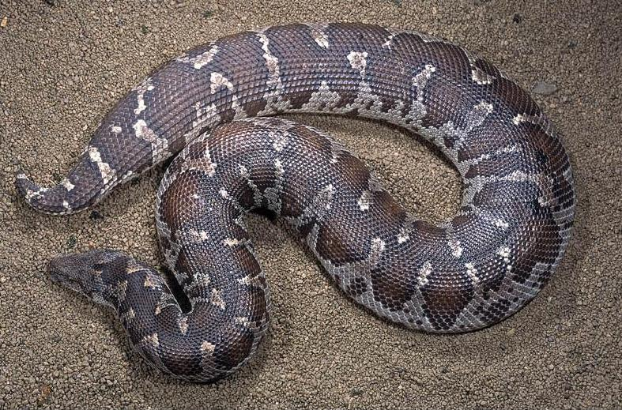
Sand Boa
Gongylophis conicus
Average Length: 50 cm
Max. length: 100 cm
Color: Mottled Brown
Shape: body short & Heavy tail short & tapering
Habitat: Dry place, nocturnal

Slide 15
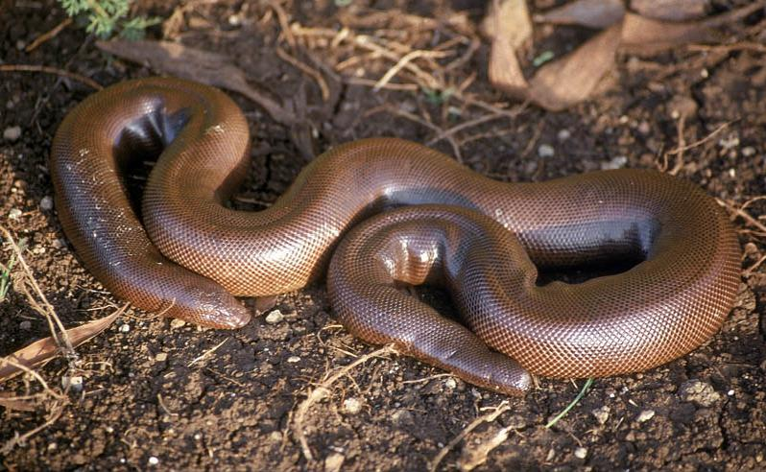
Red Sand Boa
Eryx johnii
Average Length: 75 cm
Max. length: 100 cm
Color: Reddish or
blackish Brown
Shape: Rounded
Habitat: It is speedy and deep burrower & found in dry places

Slide 16
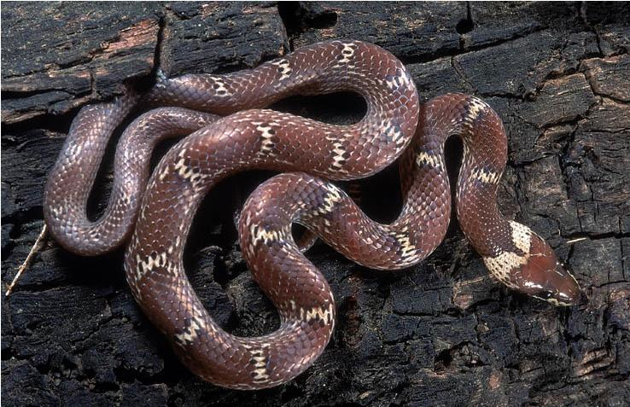
Wolf Snakes
Lycodon aulicus
Average Length: 30 cm
Max. length: 80 cm
Color: Reddish Brown with whitish yellow bands
Shape: Triangular head with rounded body
Habitat: Found near human habitation

Slide 17
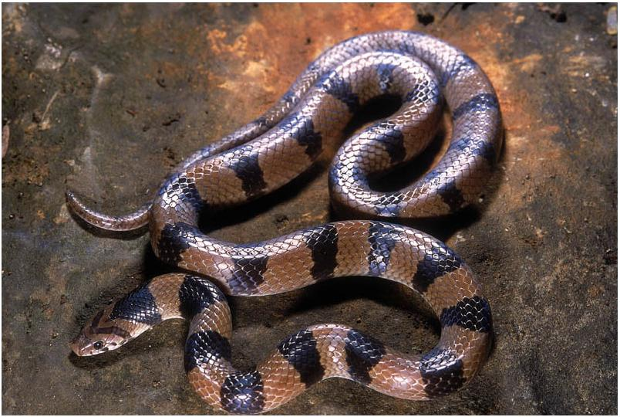
Banded Kukri
Oligodon ornensis
Average Length: 35 cm
Max. length: 70 cm
Color: Grayish & reddish
brown
Shape: on head V shaped mark & 20 black bands on body
Habitat: Desert hollow tree

Slide 18
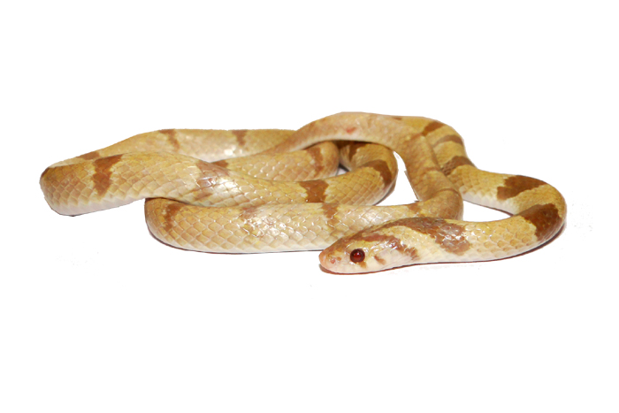
Albino Banded Kukri

Slide 19
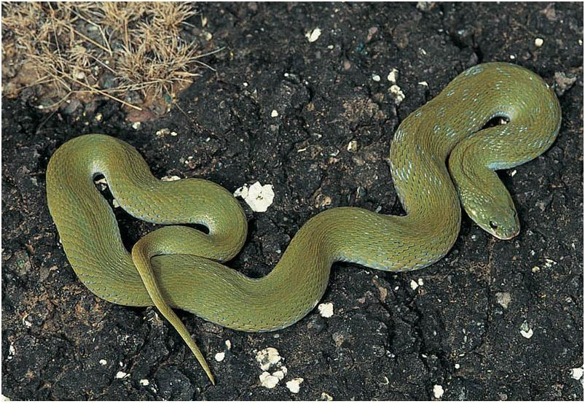
Green Keel back
Macropisthodon plumbicalor
Average Length: 50 cm
Max. length: 100 cm
Color: Mottled Brown
Shape: body short & Heavy tail short & tapering
Habitat:-Grass land, forest, near human habitation

Slide 20
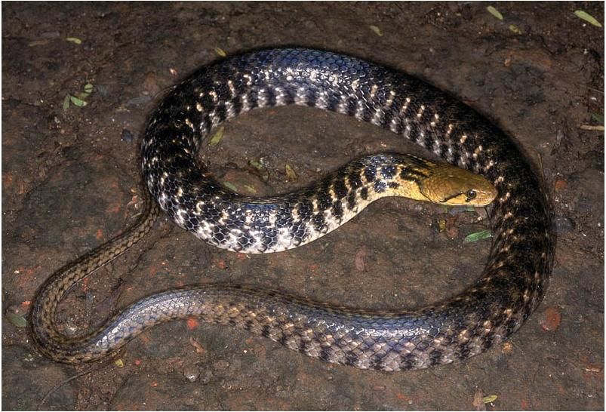
Checkered Keel back Water snake
Xenoctrophis piscator
Average Length: 60cm
Max. length: 175cm
Color: Black & yellow check alternately
Shape: Laterally compressed
Habitat:-River, pond

Slide 21
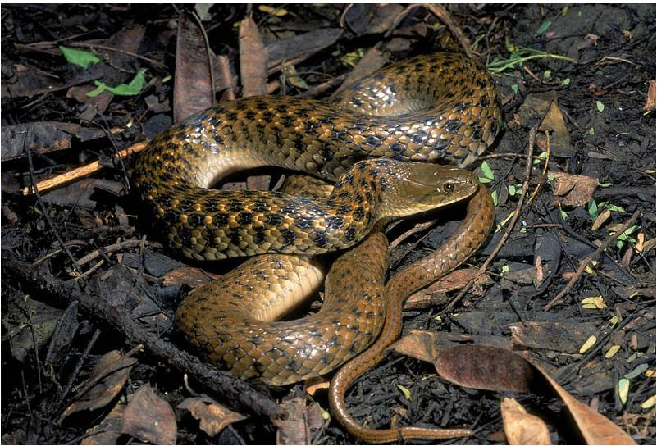
CHECKERED KEELBACK

Slide 22
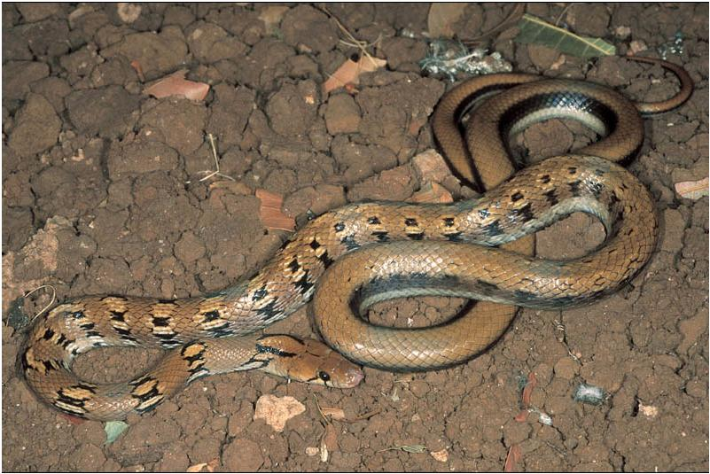
Trinket Snakes
Coeloganthus helena helena
Average Length: 70cm
Max. length: 168 cm
Color: Body ornamented with cross board
Shape: cylindrical & slender
Habitat: Usually found in forest

Slide 23
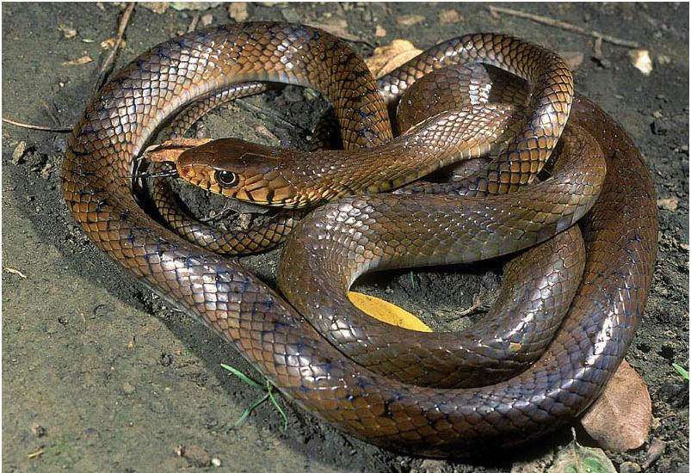
Rat Snakes
Ptyas mucosa
Average Length: 200 cm
Max. length: 350cm
Color: Brown , yellow
Shape: Rounded with large head than neck
Habitat: Grass land, forest, near human habitation

Slide 24
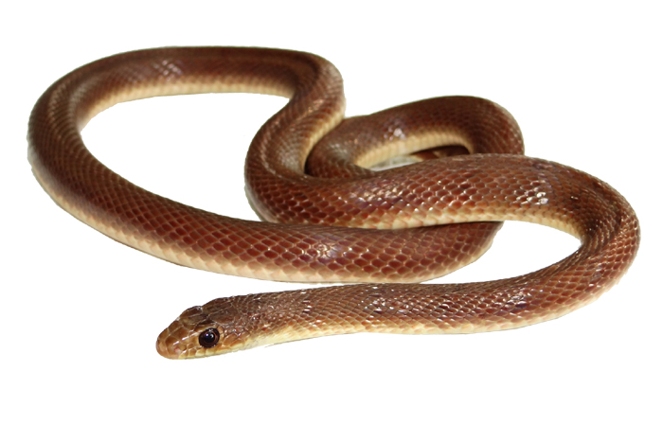
Banded Racer
Argyrogena
Average Length: 75cm
Max. length: 134 cm
Color: Faint or dark brown
Shape: Cylindrical & smooth scales
Habitat: Grassland, shrubs
fasciolata

Slide 25
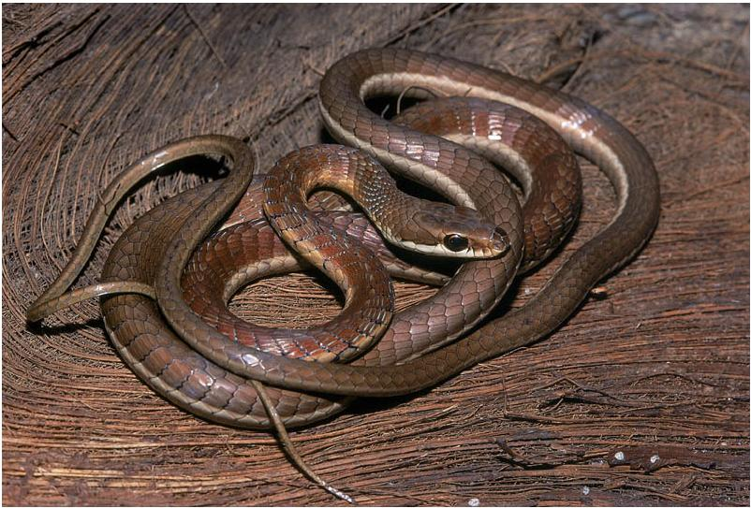
Bronze back Tree snake
wartatIl Saap
Dentrelaphis tristis
Average Length: 100cm
Max. length: 169 cm
Color: Bluish green, yellow
Shape: Long &thin
Habitat:- In Ghats , on bamboo
Saap nav

Slide 26
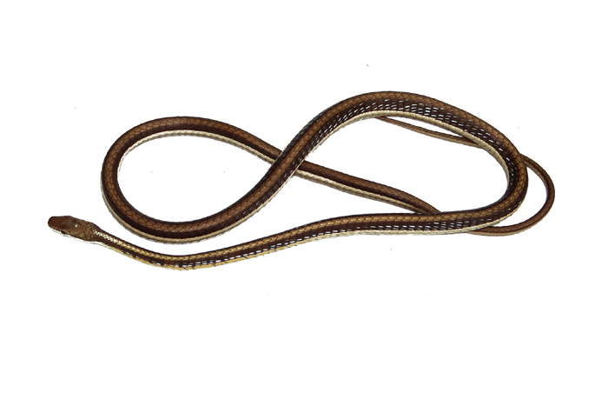
Bronze back Tree snake

Slide 27
Semi venomous snakes

Slide 28
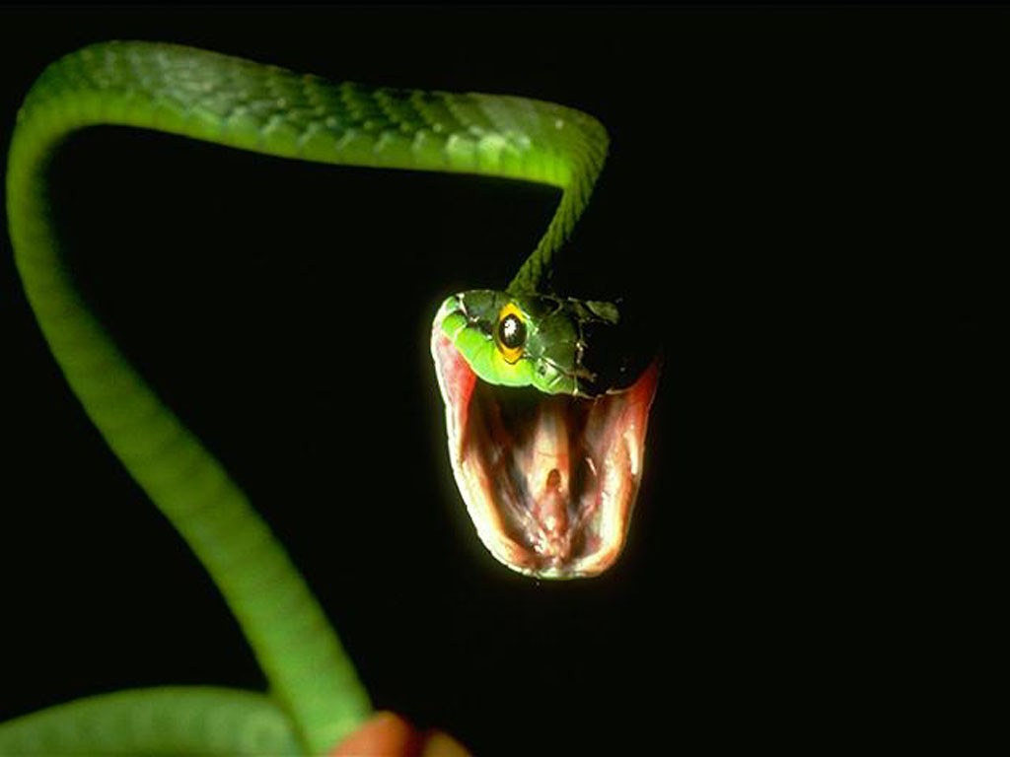
Vine Snakes
Ahaetulla nasuta
Average Length: 100cm
Max. length: 200 cm
Color: Green
Shape: Long &thin
Habitat:- In Ghats , on shrubs

Slide 29
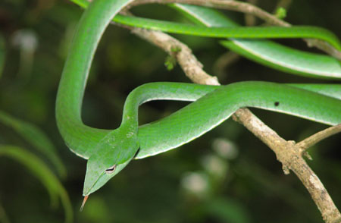

Slide 30
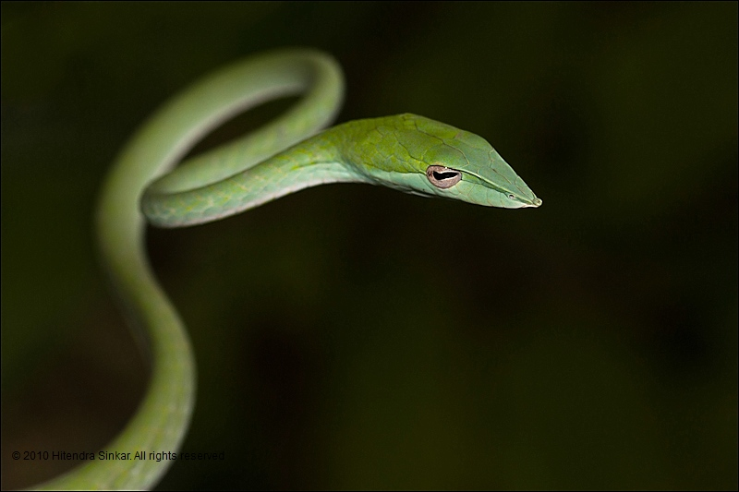

Slide 31
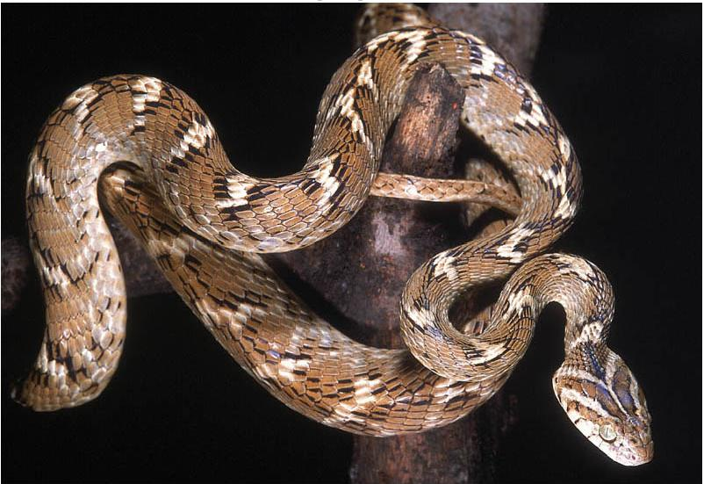
Cat Snakes
Boiga trigonata
Average Length: 75cm
Max. length: 125 cm
Color: Cat like brown and white strips
Shape :head larger than neck
Habitat:- On trees, in grassland

Slide 32
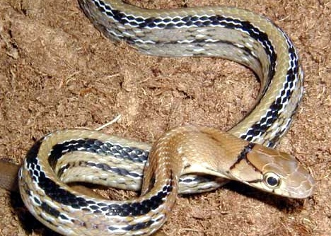
Indian Egg Eater
Elachistodan westermanni
Average Length: 80cm
Max. length: 169 cm
Color: Bluish green, Brown
Shape: Conical head
Habitat:- Almost of Maharashtra

Slide 33
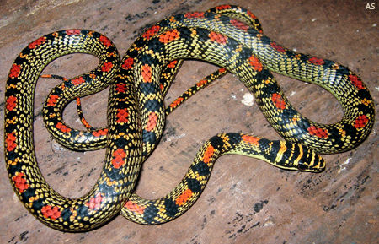
Flying Snakes

Slide 34
Venomous snakes

Slide 35
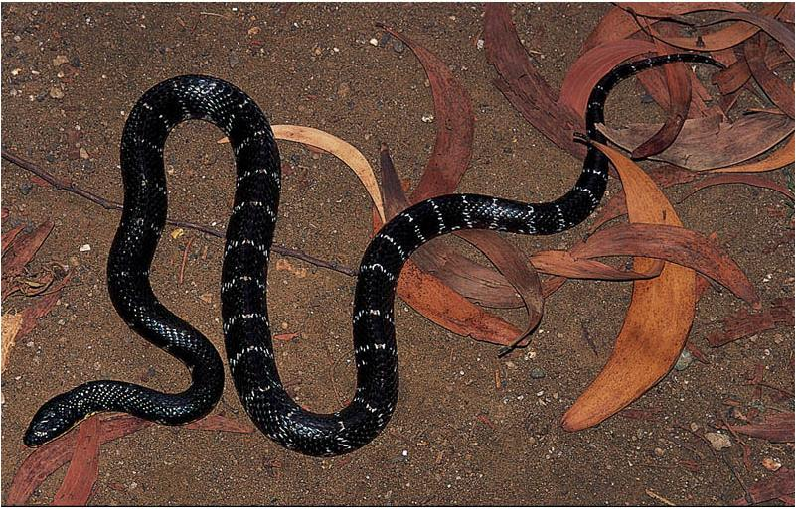
Common Krait
Bungarus caeruleus
Average Length: 100cm
Max. length: 175cm
Color: Black with white strips
Shape: Cylindrical and short in length
Habitat: Encountered in human habitat

Slide 36
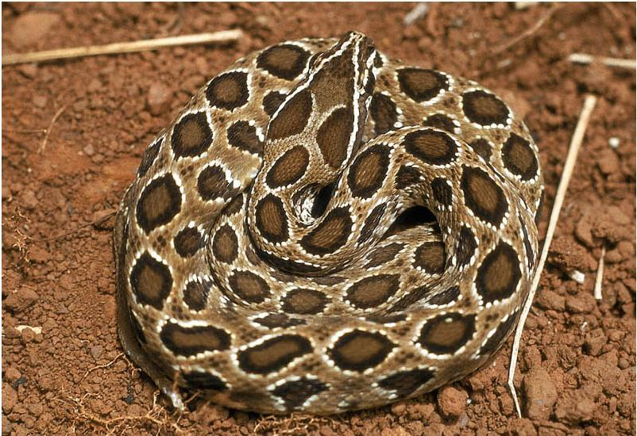
Russell's Viper
Daboia russeui
Average Length: 100cm
Max. length: 180cm
Color: brown with brownish green patches
Shape: Short tail with triangular head
Habitat:- Encountered in human habitat , grassland

Slide 37
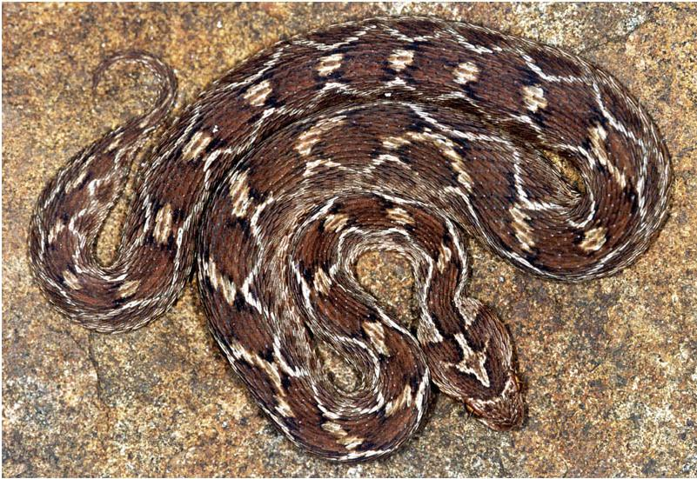
Saw-Scaled Viper
Echis corinatas
Average Length: 40cm
Max. length: 80cm
Color: Brownish with black bordered patches
Shape: Triangular head with short tail
Habitat: Encountered in human habitat, grassland

Slide 38
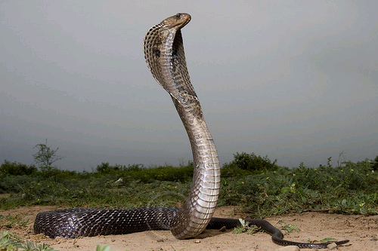
Cobra
Naja naja
Average Length: 100cm
Max. length: 220cm
Color: Brown, black, grey
Shape: Bear’s fangs , short in length
Habitat:- All over India

Slide 39
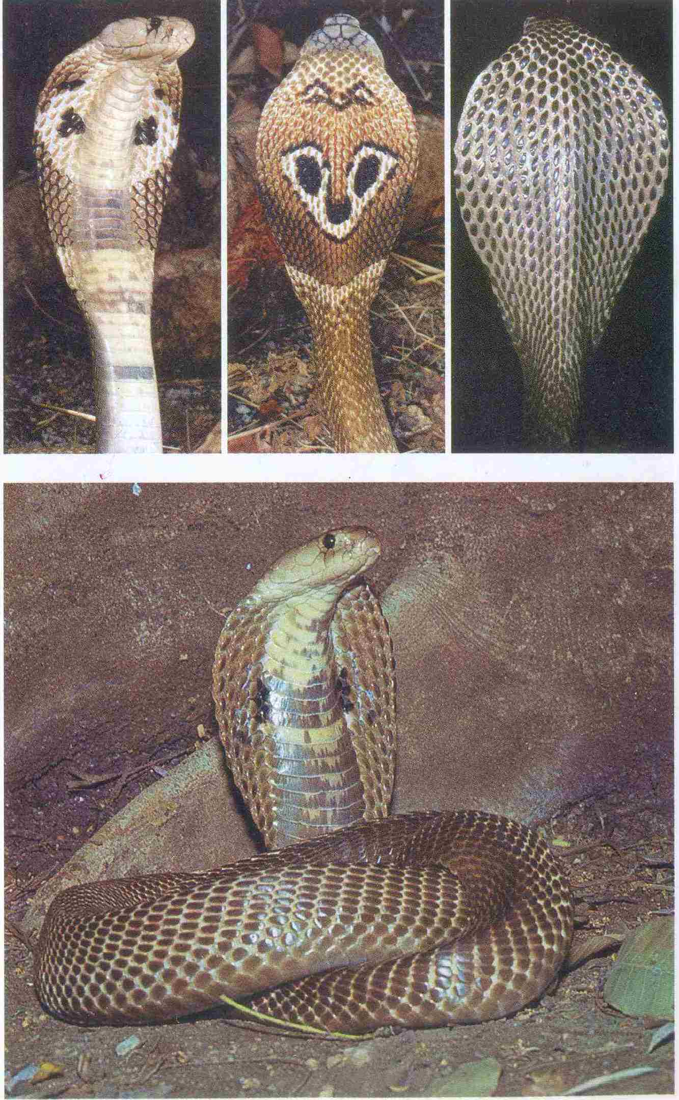

Slide 40
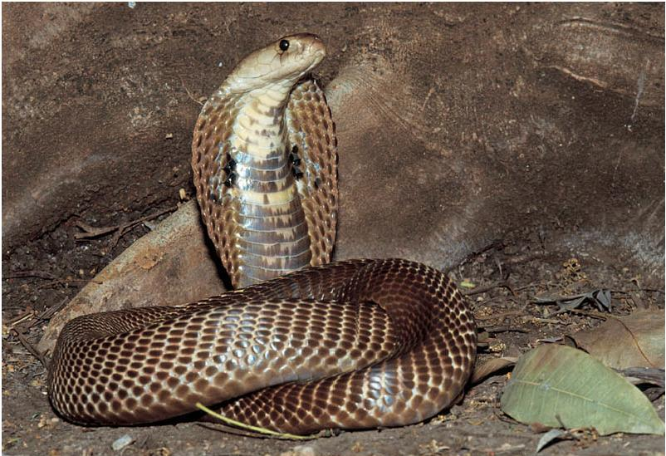

Slide 41
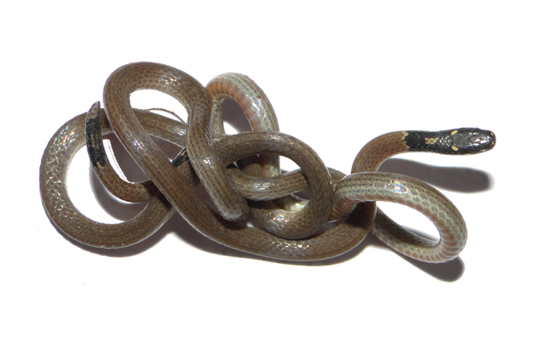
Coral Snake

Slide 42
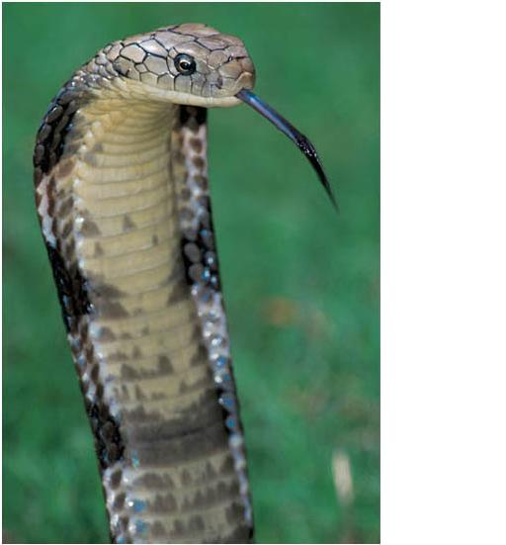
King Cobra

Slide 43
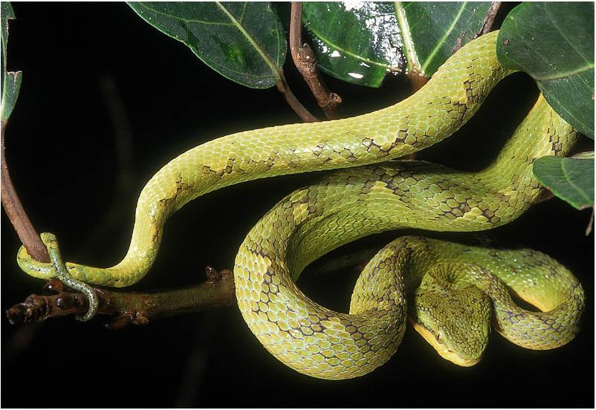
Pit Viper

Slide 44
Snake Venoms

Slide 45
Venom Contain
Protein 90%
Enzyme 8%
Other Substance 2%

Slide 46
Venom Content
Protein s responsible for toxicity
Enzyme for digestion
Other substance for lethal biological action

Slide 47
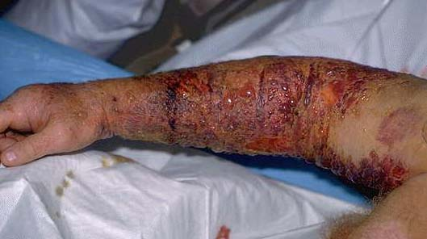
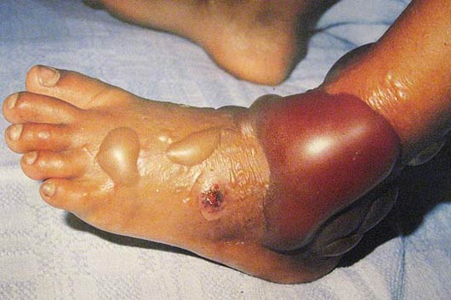

Slide 48
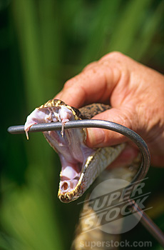
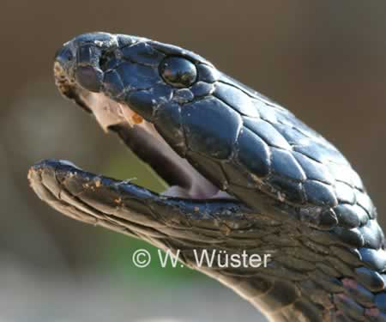

Slide 49


Slide 50
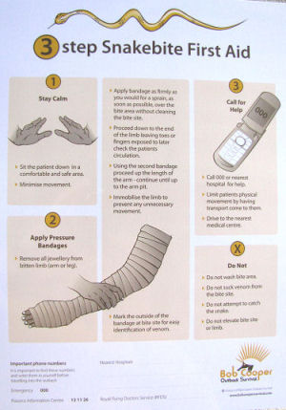

Slide 51
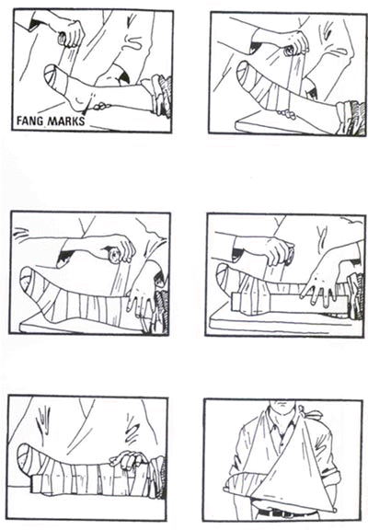
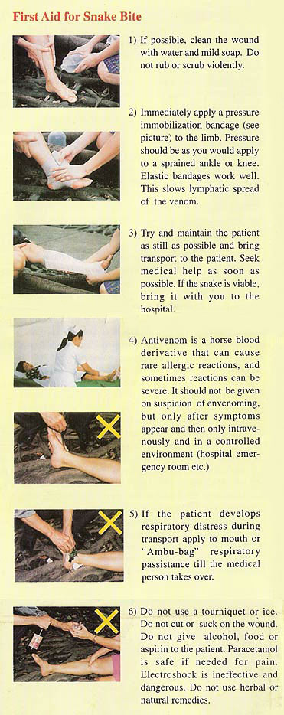

Slide 52
Myths & Beliefs

Slide 53
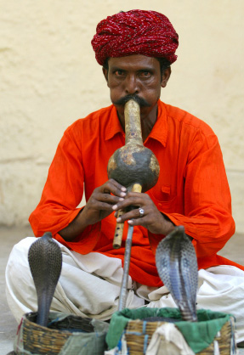

Slide 54
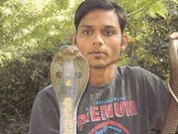
Snake Handling

Slide 55


Slide 56

This is natural

Slide 57

This is belief of man

Slide 58
Rescue of animal
Snake & Birds

Slide 59

Rescue a cobra from cannel.

Slide 60

Rescue a Barn Owl

Slide 61

Feeding

Slide 62

THANK YOU

